Slide 1

Group 2: Credit Card Approval Prediction
Cody Gardner
Bradley Barker
David Owens
Marie Prosper

Slide 2


Overview
Background
Goal
Technologies and Data Source
Process
Machine Learning
Website
Model Usage

Slide 3

Background
Applying for a credit card can be intimidating for some people. Many applications ask for your social security number and your credit may get hit with a hard inquiry. We wanted to use a machine learning model remove this friction.

Slide 4

Goal
To predict whether the credit card application will be approved or denied.
Show approval predictor
Show denial predictor
Predicts the odds based on:
Number of Children
Household Income
Family Size
Gender
Own Car
Own Realty
Regression Model

Slide 5












Technologies
Data Source
Python (Jupyter Notebook, Pandas, numpy, sklearn, matplotlib)
Flask
SQL/ Postgres DB
HTML/ CSS (Bootstrap)
CSV
Machine Learning
https://www.kaggle.com/rikdifos/credit-card-approval-prediction
Notes:
MARIE

Slide 6
Process
Data Cleaning
Removing extraneous columns
Null values
Duplicates
Merging datasets by grouping the datasets
Individual scatter plots for each feature
Regularization: Coefficient plots XXXX
Function to test the familiar Regressors
Scaling the data
Model Selection & Prediction
MSE & R-squared score: Lesson Learnt
Exported the model
Flask implementation
Heroku deployment

Slide 7
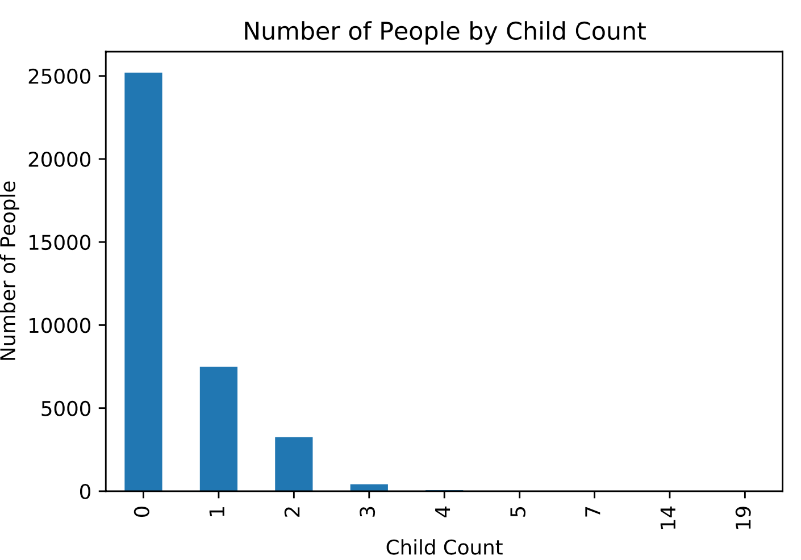
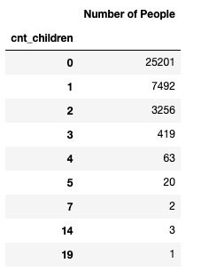
Data Preparation and Overview
Notes:
CODY
Talk through how the data was originally set up as a time series and that you had to create a new target column or dependent variable called “Credit Risk”. People were labeled as high risk if they missed a payment and people were labeled as low risk if they did not miss a payment.
Number of Children
Household Income
Family Size
Gender
Own Car
Own Realty
Feature Selection:
Number of Children
Household Income
Family Size
Gender
Own Car
Own Realty

Slide 8
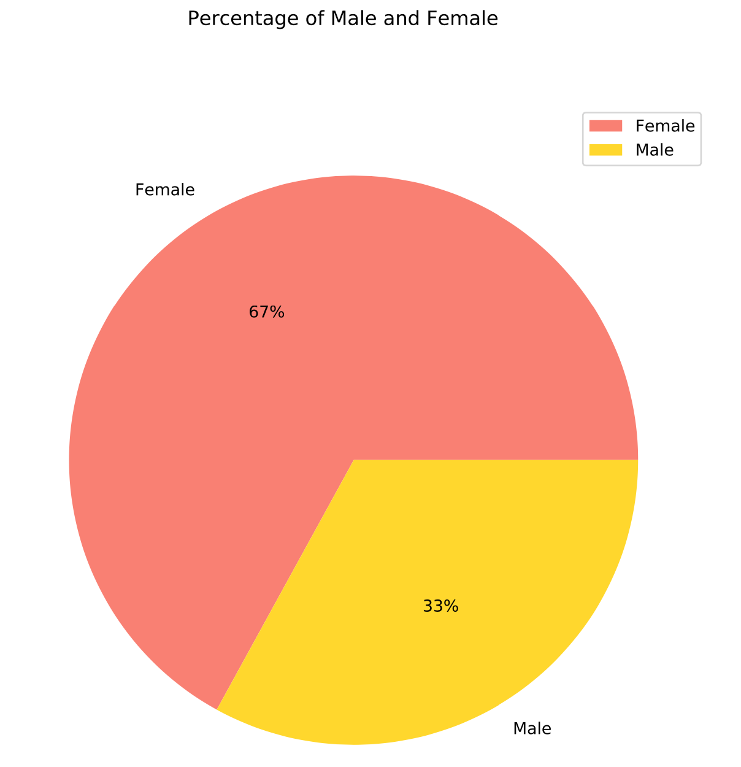
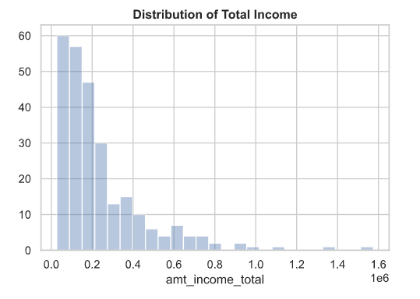
Data Preparation and Overview
Notes:
CODY
Talk through how the data was originally set up as a time series and that you had to create a new target column or dependent variable called “Credit Risk”. People were labeled as high risk if they missed a payment and people were labeled as low risk if they did not miss a payment.
Number of Children
Household Income
Family Size
Gender
Own Car
Own Realty
Feature Selection:
Number of Children
Household Income
Family Size
Gender
Own Car
Own Realty

Slide 9
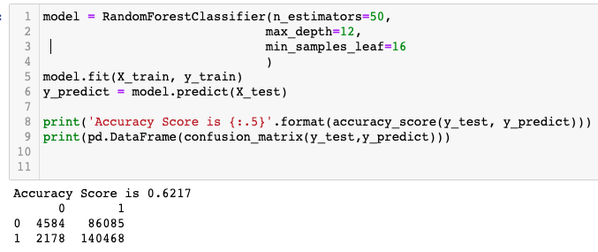
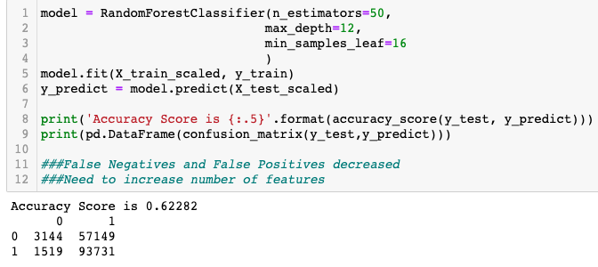
Machine Learning
Supervised Machine Learning Models
Random Forest
Logistics Regression
Used these models because the dependent variable is binary
Dependent Variable in this study was “High Risk” and “Low Risk”
Notes:
CODY
The machine learning models that we used was the Random Forest and Logistics Regression models. We used these models because the dependent variable is binary meaning it was either “True or False” in this case “High Risk” or Low Risk”. We ran the models without scaling the data and the best accuracy result came from the Random Forest model at 61%. We noticed that there were a lot of false positives which is why we decided to scale the data to see if we can get a better accuracy result. After scaling the data, we increased our accuracy to 62%.
Number of Children
Household Income
Family Size
Gender
Own Car
Own Realty
Feature Selection:
Number of Children
Household Income
Family Size
Gender
Own Car
Own Realty

Slide 10
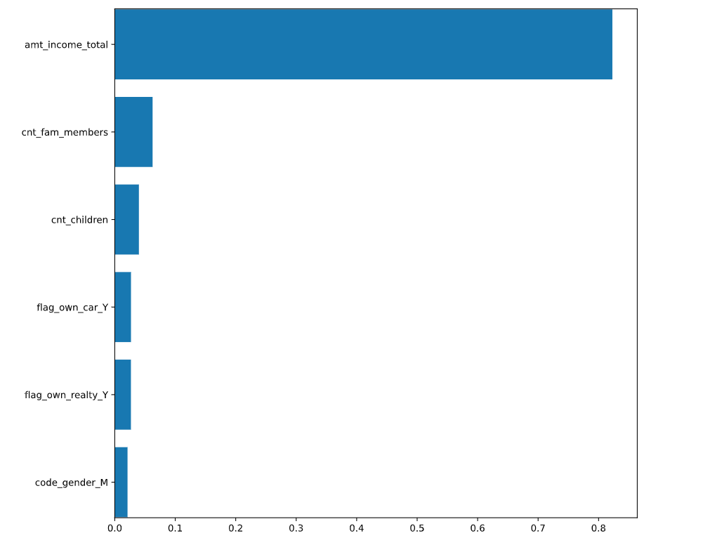
Feature Selection
Notes:
CODY
Go over feature selection and how income is the largest factor
Feature Selection
Number of Children
Household Income
Family Size
Gender
Own Car
Own Realty
Number of Children
Household Income
Family Size
Gender
Own Car
Own Realty
Feature Selection:
Number of Children
Household Income
Family Size
Gender
Own Car
Own Realty

Slide 11

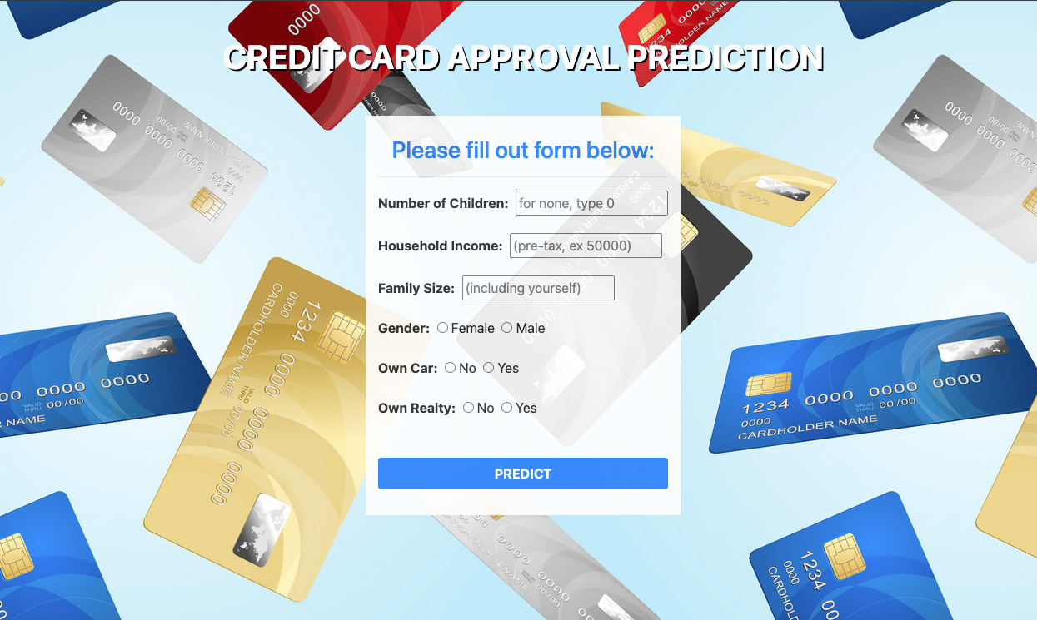

Website
SCAN ME:
Notes:
BRADLEY
We wanted to create a pleasant experience for the end user, so we put a lot of effort into User Experience and Interface. Feel free to scan the QR code to the right to check out the site yourself. We also thought it was important to simplify the site, as it is supposed to make the process of applying for a credit card more smooth, not more intimidating.

Slide 12
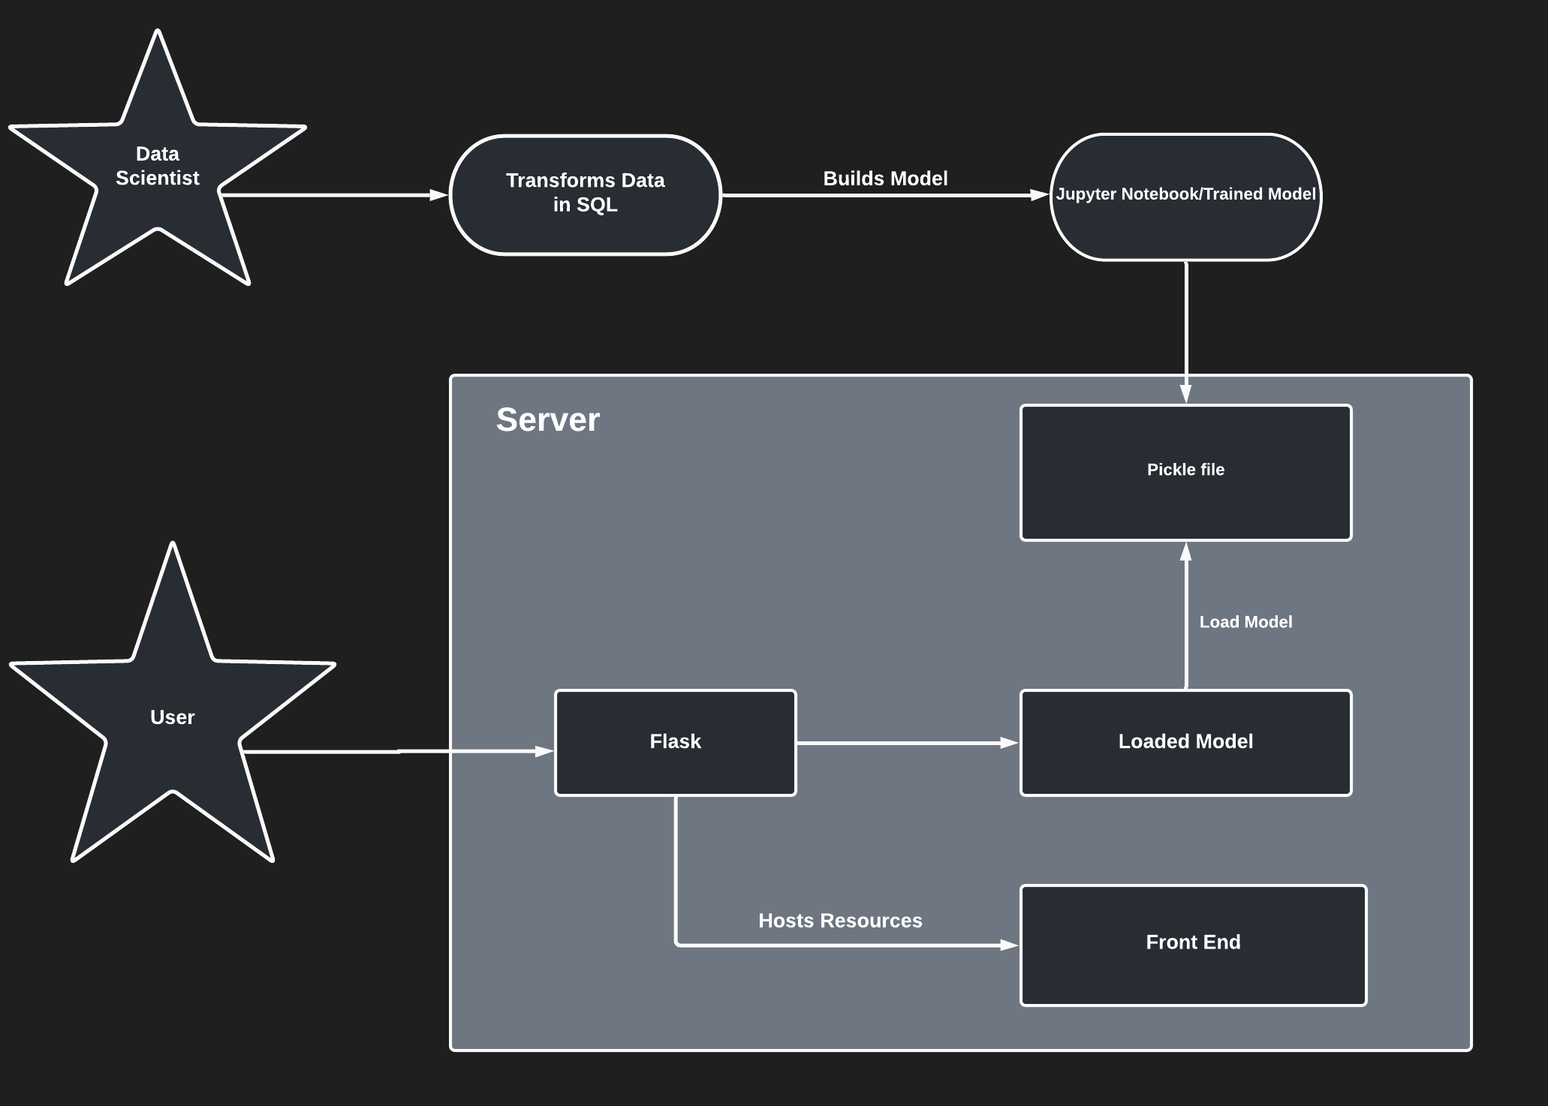
Model Usage
Notes:
DAVID?

Slide 13
Limitations
Uncertain kaggle dataset origin
Limited dependent variables
62% model prediction accuracy
No limits on user entry
Notes:
The kaggle page wasn’t clear where the data came from, so the application of the model is limited to just the theoretical, and should not be generalized
We limited the dependent variables of the dataset to some simpler and possibly less accurate measurements to support our cause of making the process less intimidating. For example, we could have asked what were the remaining balances of your previous credit card statements for the past 3 months and did you pay each month off on time, but we deemed that to be intimidating to the user.
The model was only 62% accurate in its prediction, so it doesn’t have the best predicting capability
Because we didn’t limit user entry, some entries may not be accurate
Let’s make sure to practice presenting with the presenter mode***

